Slide 1
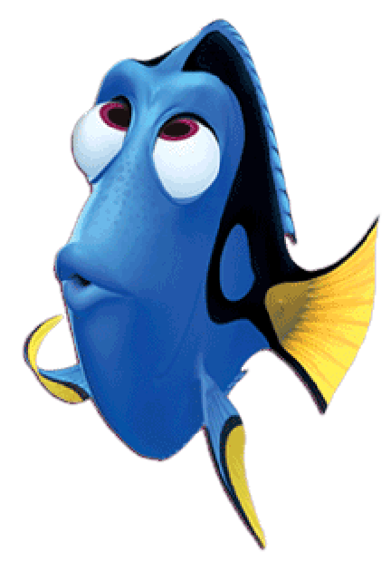
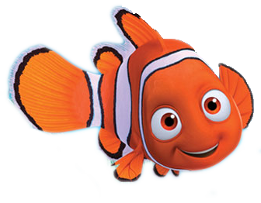
Can you help me find my friend Dory?

Slide 2
Want to know a secret?

Slide 3
Dory likes red circles.

Slide 4
Which one is the red circle?

Slide 5
GREAT JOB!

Slide 6
What color is the other circle?

Slide 7
Let’s find all of the red circles!

Slide 8
Can you help me find my friend Dory?

Slide 9
Want to know a secret?

Slide 10
Dory likes black circles.

Slide 11
Which one is the black circle?

Slide 12
GREAT JOB!

Slide 13
What color is the other circle?

Slide 14
Let’s find all of the black circles!

